Slide 1
INTRACRANIAL HEMORRHAGE
Guided by : Dr Arpitha Mam

Slide 2
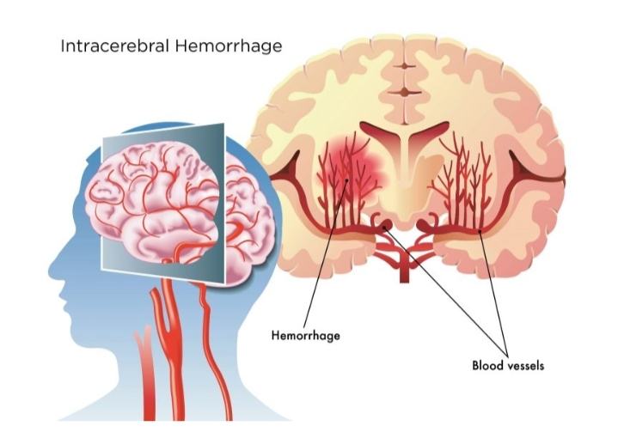
Intracerebral Hemorrhage

Slide 3
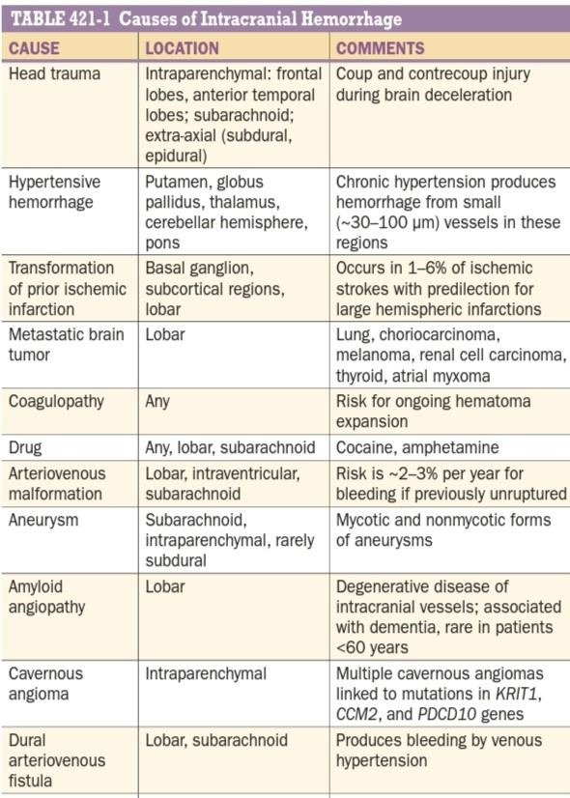

Slide 4
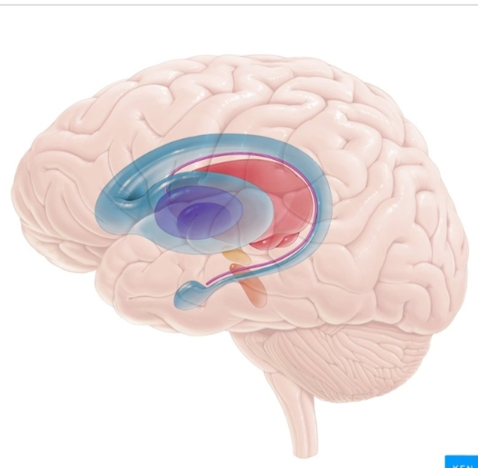
SITES:-
Thalamus
Putamen
Cerebellum
Pons

Slide 5
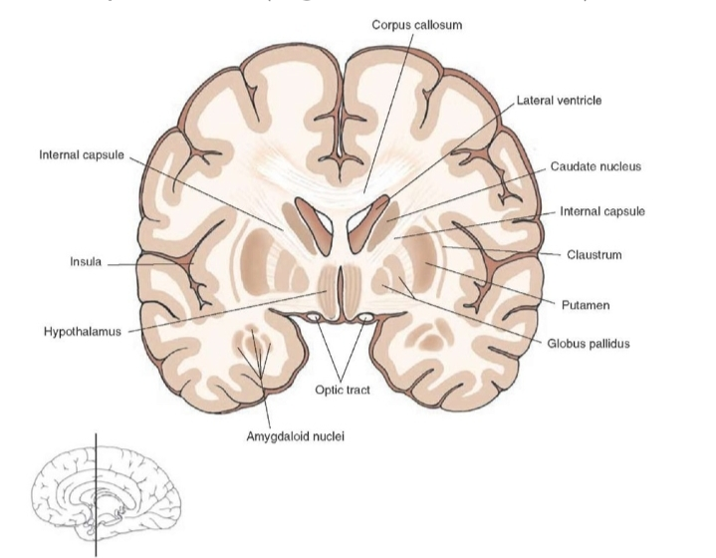

Slide 6
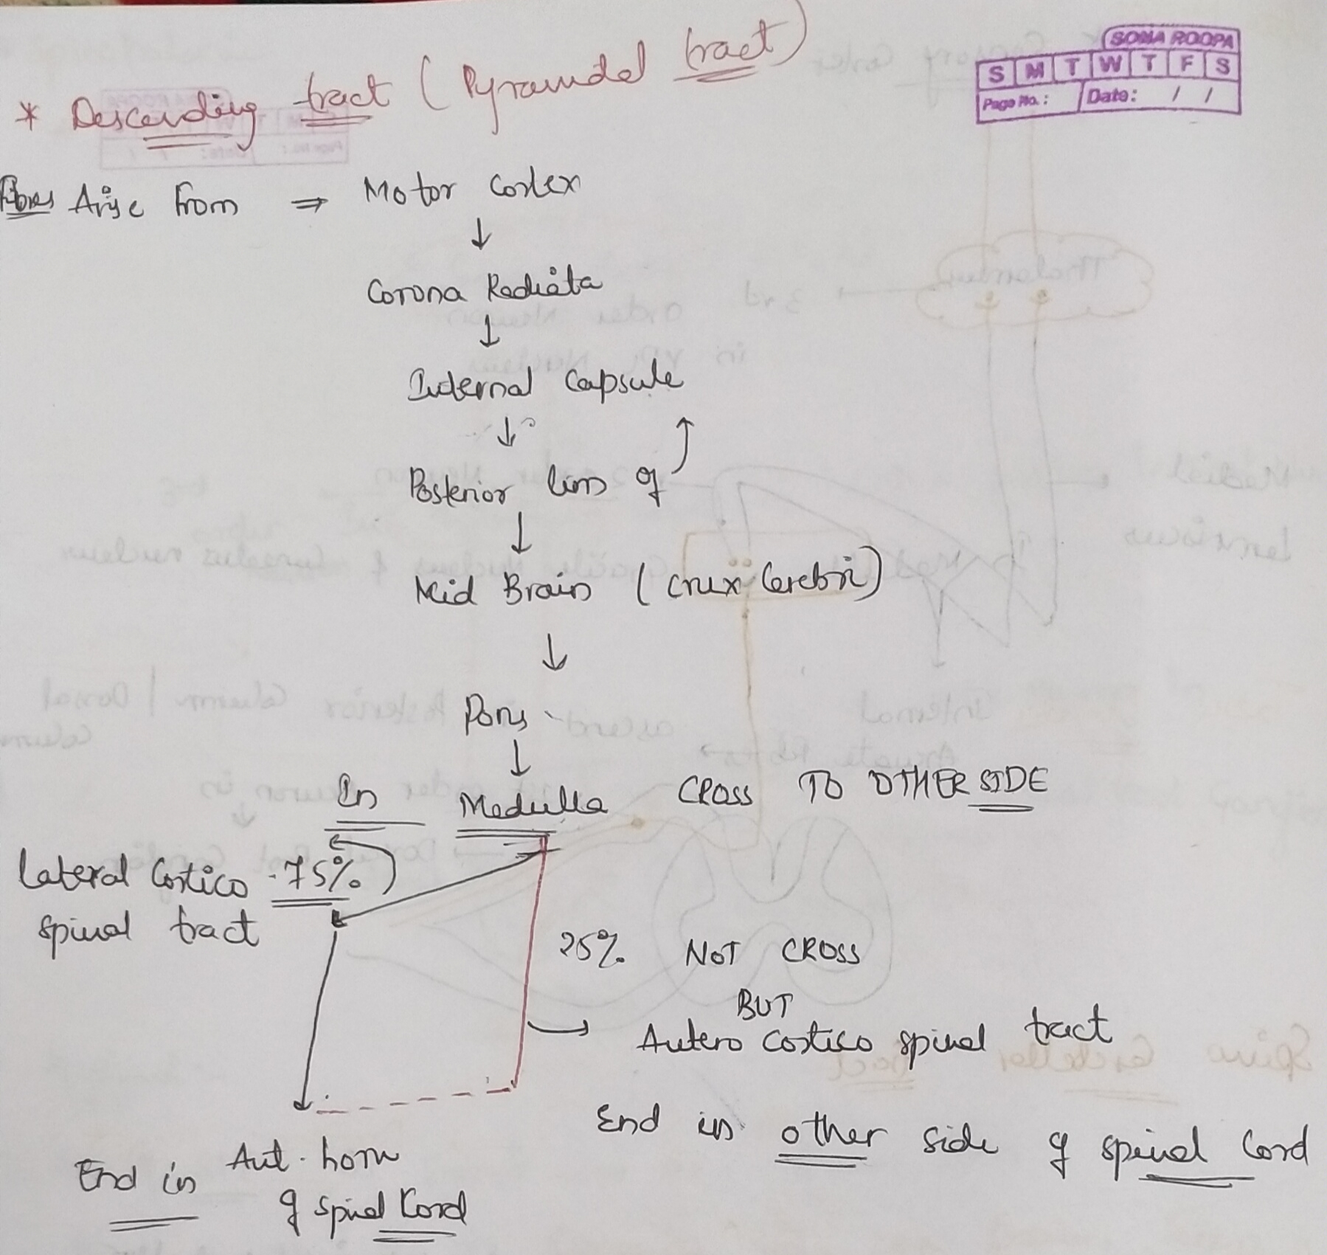
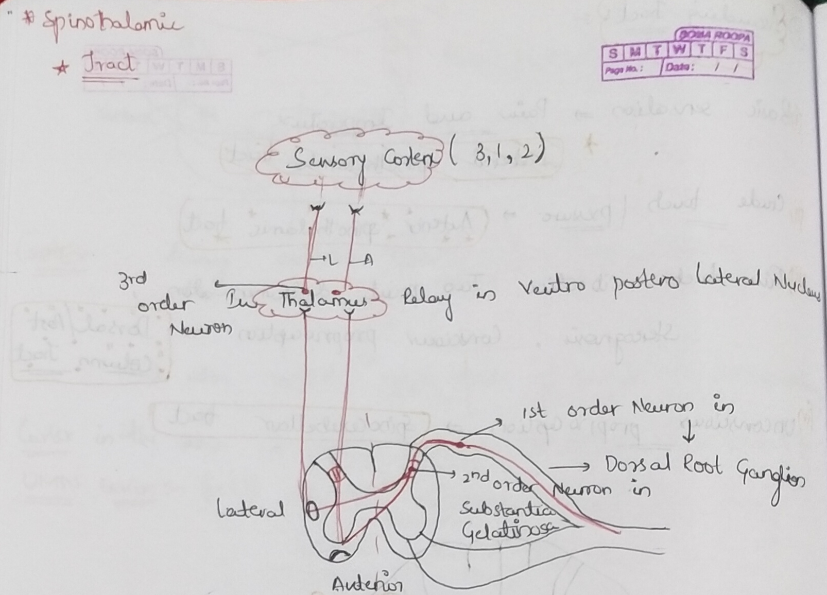

Slide 7
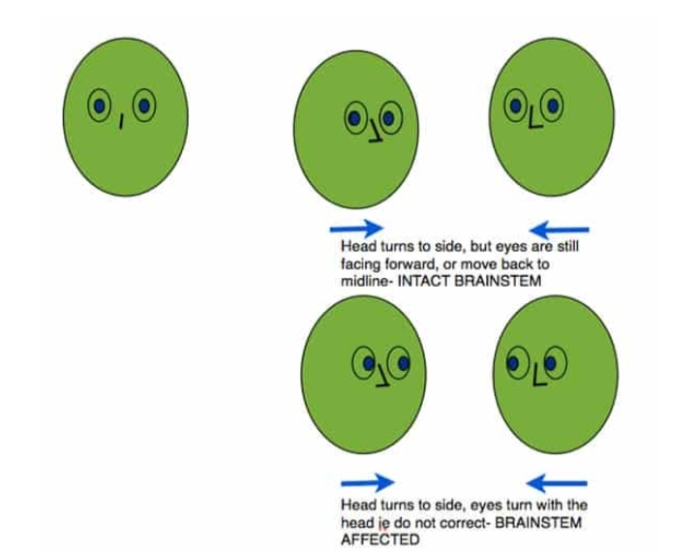
DOLL’S EYE REFLEX :

Slide 8
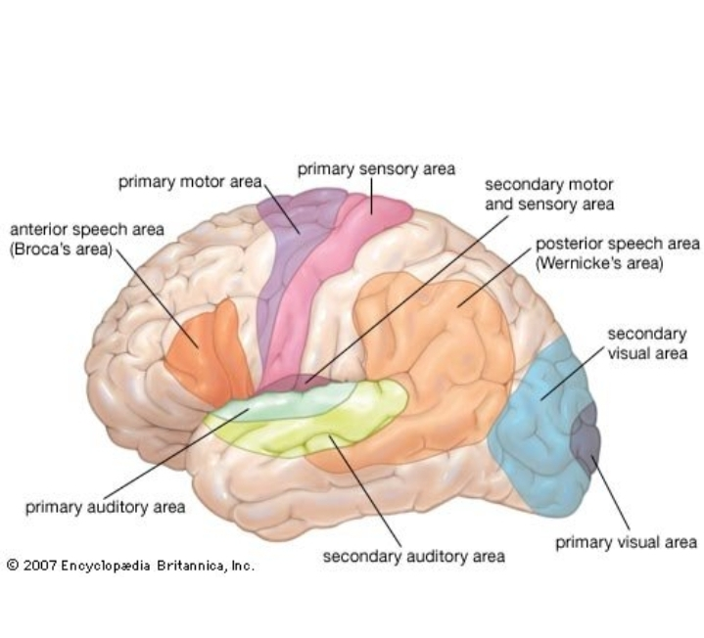
Lobar Hemorrhage

Slide 9
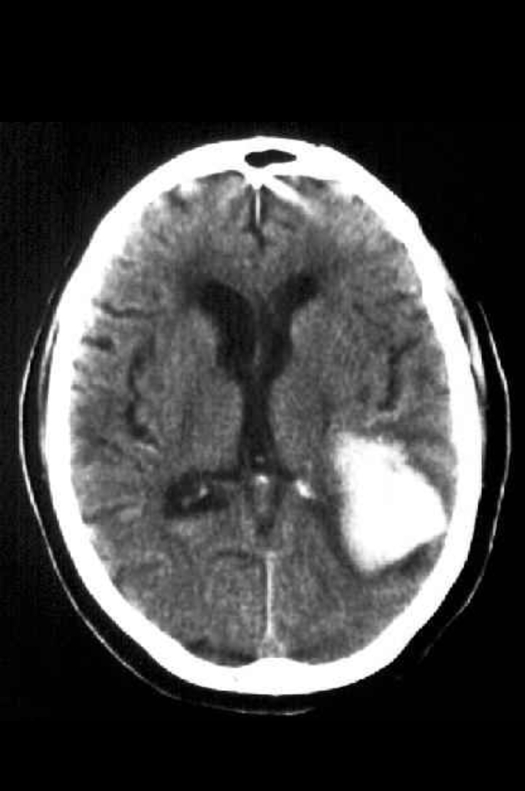
INVESTIGATIONS

Slide 10
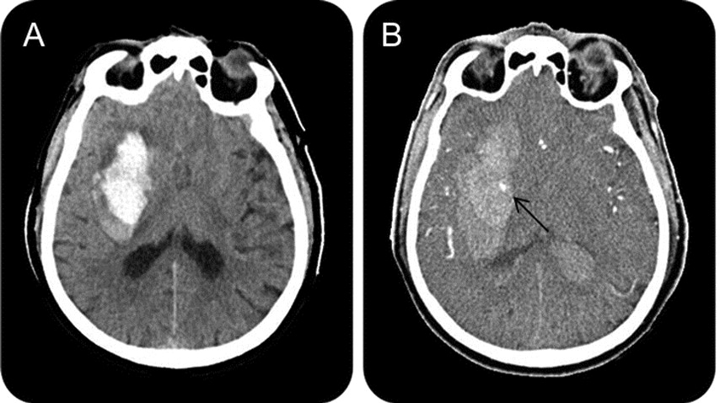
Spot Sign

Slide 11
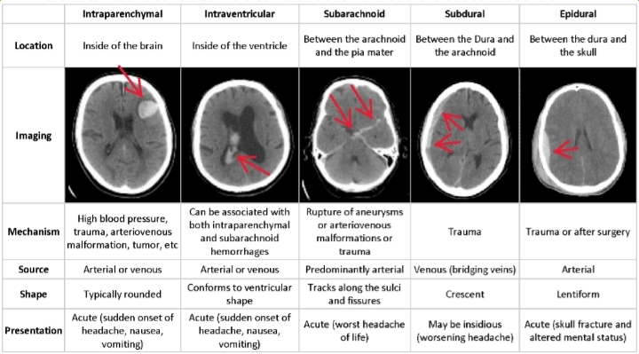
Types:

